Slide 1
미래차 부트캠프 On-device AI
Lecture 6: Polling and Interrupt
Jong Hwan Ko
Associate Professor
SungKyunKwan University, Korea
Department of Electrical and Computer Engineering
jhko@skku.edu

Slide 2
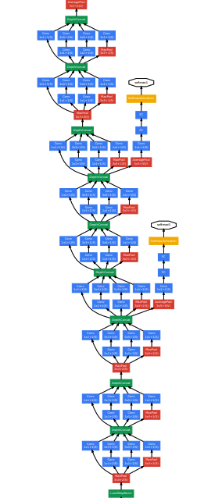

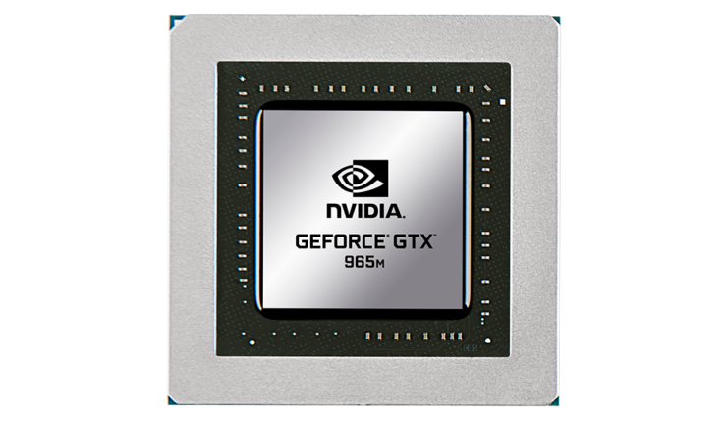
7. Mapping & Dataflow
Mapping onto Hardware
MAPPING
Loop reordering
Loop tiling
Loop unrolling
Vectorization
Edge-host partitioning
DLA
(Deep Learning Accelerator)
Adapted from “Machine Learning Hardware and Systems” Lecture (Fall 2024) by Prof. M. Abdelfattah (Cornell Tech)

Slide 3
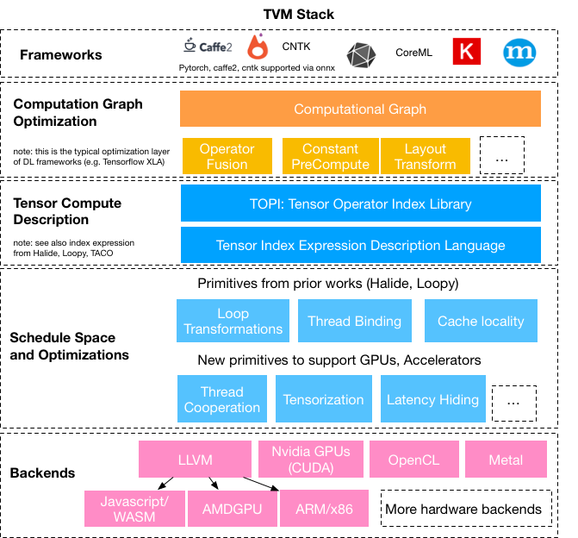
7. Mapping & Dataflow
ML Compiler
source: sampl.cs.washington.edu/projects/tvm.html

Slide 4
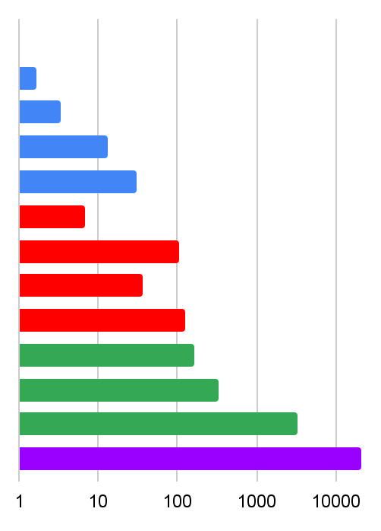
7. Mapping & Dataflow
Motivation: Memory Hierarchy
Operation | Precision | Energy (pJ)
Addition | INT8 | 0.03
 | INT16 | 0.05
 | INT32 | 0.1
 | FP16 | 0.4
 | FP32 | 0.9
Multiplication | INT8 | 0.2
 | INT32 | 3.1
 | FP16 | 1.1
 | FP32 | 3.7
32-bit SRAM Read (8 kB) |  | 5
32-bit SRAM Read (32 kB) |  | 10
32-bit SRAM Read (1 MB) |  | 100
32-bit DRAM Read |  | 640
Relative Energy Cost (Log-scale)
Memory is the issue!
Adapted from Mark Horowitz “Computing’s Energy Problem (and What we can do about it)” ISSCC 2014

Slide 5
7. Mapping & Dataflow
Motivation: Memory Hierarchy
Get data close to the computation. (LOCALITY)
Once data is close - perform all computations with this data. (REUSE)
Relative Energy Cost (Log-scale)
Operation |  | Energy (pJ)
32-bit SRAM Read (8 kB) |  | 5
32-bit SRAM Read (32 kB) |  | 10
32-bit SRAM Read (1 MB) |  | 100
32-bit DRAM Read |  | 640
Adapted from “Machine Learning Hardware and Systems” Lecture (Fall 2024) by Prof. M. Abdelfattah (Cornell Tech)

Slide 6
7. Mapping & Dataflow
Register File
Motivation: Memory Hierarchy
Private memory
Local Memory
Why do we have a memory hierarchy?
The closer you get to compute, the more $$ and scarce the memory resource becomes
In most cases, the DNN parameters live off chip and are fetched layer-by-layer or tile-by-tile
Data locality: how to get data close to the PEs (to keep them fully utilized)
Accelerator Chip
Shared Memory
Cache
On-Chip Buffer
On-Chip Memory
SRAM
PE
MB
KB
External Memory
Main Memory
Global Memory
Off-Chip Memory
DRAM / HBM
GB
Adapted from “Machine Learning Hardware and Systems” Lecture (Fall 2024) by Prof. M. Abdelfattah (Cornell Tech)

Slide 7
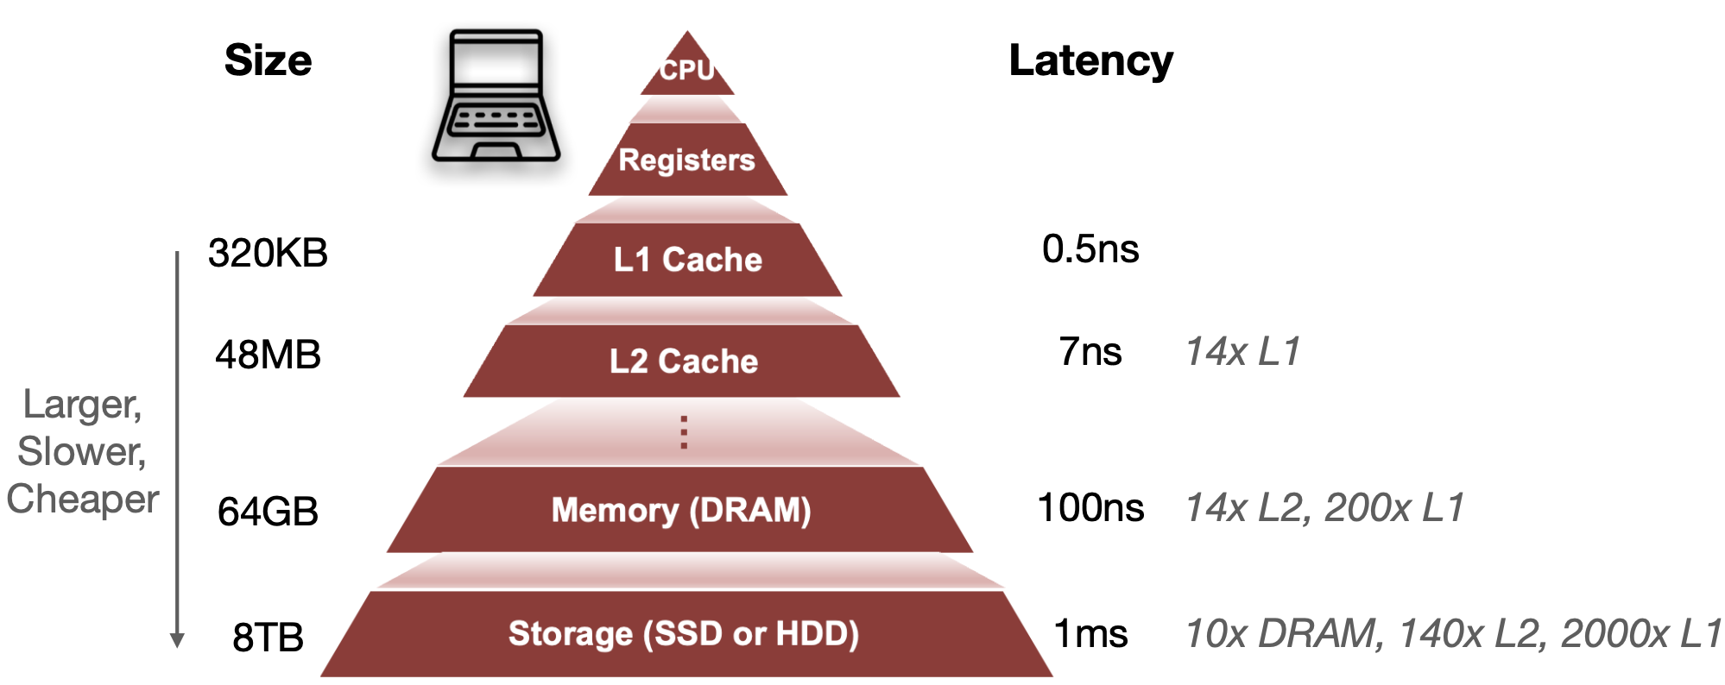
7. Mapping & Dataflow
Motivation: Memory Hierarchy
Adapted from “TinyML and Efficient Deep Learning Computing” Lecture (Fall 2024) by Prof. Song Han (MIT)

Slide 8
7. Mapping & Dataflow
Motivation: Data Reuse
Temporal Reuse
Spatial Reuse
Read once from memory, use same data multiple times by same PE
Read once from memory, use same data multiple times by multiple PEs
PE
Memory
PE
x
3
1
2
5
x
3
Memory
PE
Reuse entry multiple times from a single memory read
3
Reuse entry multiple times from a single memory read
x
PE
x
3
Adapted from “Machine Learning Hardware and Systems” Lecture (Fall 2024) by Prof. M. Abdelfattah (Cornell Tech)

Slide 9
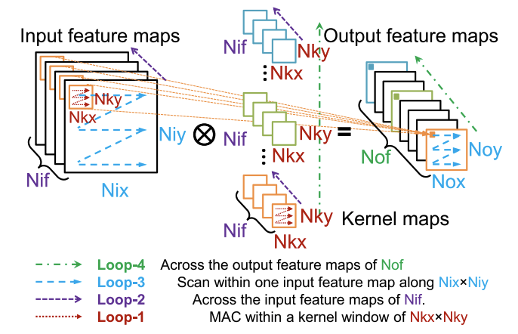
7. Mapping & Dataflow
Loop Optimization
Reordering
Tiling
Unrolling
Y. Ma et al., Optimizing the Convolution Operation to Accelerate Deep Neural Networks on FPGA

Slide 10
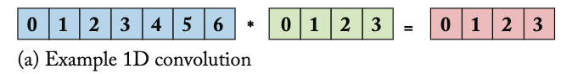
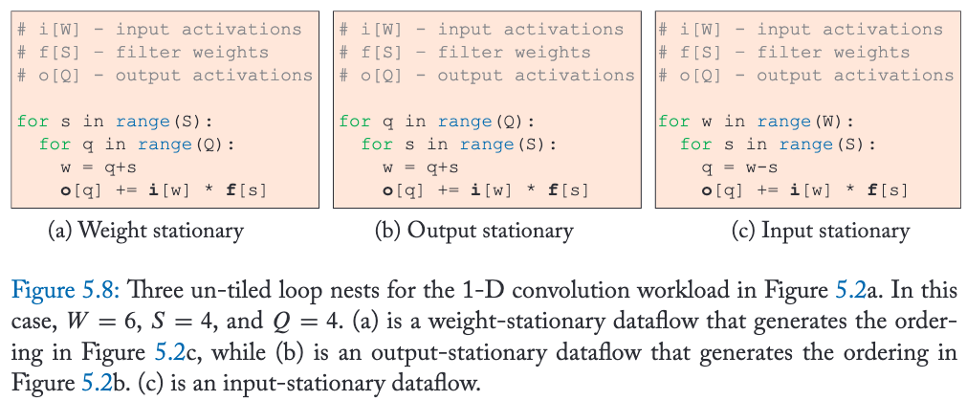
7. Mapping & Dataflow
filter
input
output
Example: 1D Convolution
0
0
0
0
1
1
0
2
2
0
3
3
y = F.conv1d(x)
1
1
0
1
2
1
1
3
2
Library Call
1
4
3
2
2
0
2
3
1
2
4
2
2
5
3
time
Adapted from “Machine Learning Hardware and Systems” Lecture (Fall 2024) by Prof. M. Abdelfattah (Cornell Tech)

Slide 11
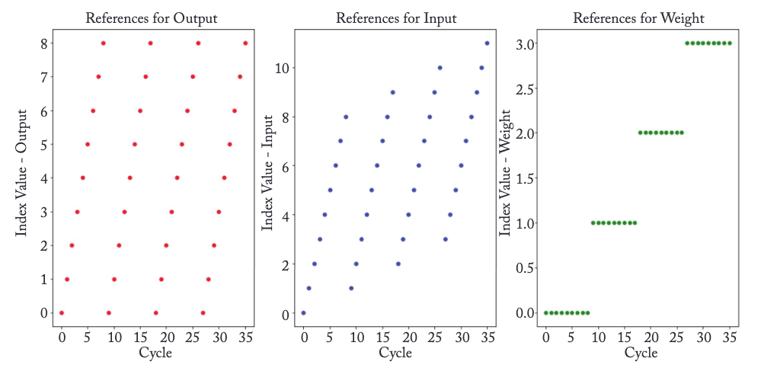
7. Mapping & Dataflow
Example: 1D Convolution
What effect will this have on a cache size of 4?
Where should we map the weights?
on-chip RAM, registers, or DRAM
Cache eviction and refetching multiple times
Output (q) | 0 | 1 | 2 | 3 | 4 | 5 | 6 | 7 | 8 | 0 | 1 | 2 | 3 | 4 | 5 | 6 | 7 | 8 | 0 | 1 | ..
Input (w) | 0 | 1 | 2 | 3 | 4 | 5 | 6 | 7 | 8 | 1 | 2 | 3 | 4 | 5 | 6 | 7 | 8 | 9 | 2 | 3 | ..
Weight (s) | 0 | 0 | 0 | 0 | 0 | 0 | 0 | 0 | 0 | 1 | 1 | 1 | 1 | 1 | 1 | 1 | 1 | 1 | 2 | 2 | ..
Adapted from “Machine Learning Hardware and Systems” Lecture (Fall 2024) by Prof. M. Abdelfattah (Cornell Tech)
Notes:
Input 12
Weight 4
Output 9
Input (w) : 0 1 2 3 4 5 6 7
Weight (s) : 0 0 0 0 0 0 0 0
Output (q) : 0 1 2 3 4 5 6 7

Slide 12
7. Mapping & Dataflow
Mapping: Dataflow Selection
?
?
Adapted from “Machine Learning Hardware and Systems” Lecture (Fall 2024) by Prof. M. Abdelfattah (Cornell Tech)

Slide 13
7. Mapping & Dataflow
Mapping: Dataflow Selection
Compiler can re-order loops without changing functionality
Compiler heuristics can model the approximate effect on runtime and memory access
Adapted from “Machine Learning Hardware and Systems” Lecture (Fall 2024) by Prof. M. Abdelfattah (Cornell Tech)

Slide 14
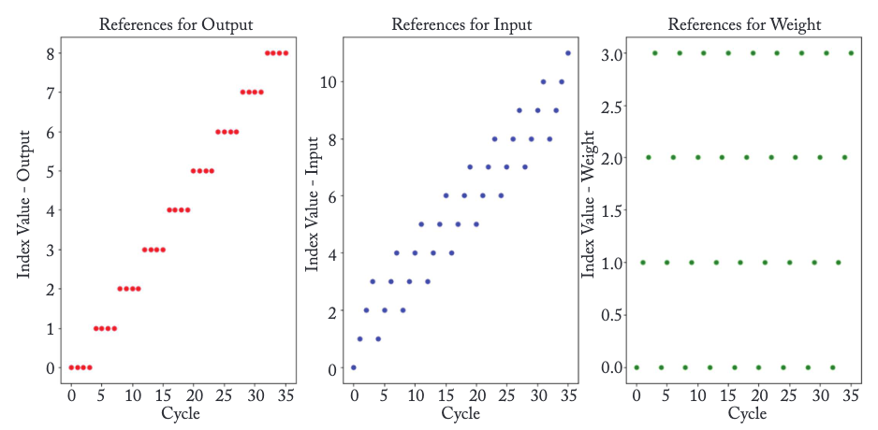
7. Mapping & Dataflow
Dataflow Choice (Loop reordering)
Output (q) | 0 | 1 | 2 | 3 | 4 | 5 | 6 | 7 | 8 | 0 | 1 | 2 | 3 | 4 | 5 | 6 | 7 | 8 | 0 | 1 | ..
Input (w) | 0 | 1 | 2 | 3 | 4 | 5 | 6 | 7 | 8 | 1 | 2 | 3 | 4 | 5 | 6 | 7 | 8 | 9 | 2 | 3 | ..
Weight (s) | 0 | 0 | 0 | 0 | 0 | 0 | 0 | 0 | 0 | 1 | 1 | 1 | 1 | 1 | 1 | 1 | 1 | 1 | 2 | 2 | ..
Loop reordering
Output (q) | 0 | 0 | 0 | 0 | 1 | 1 | 1 | 1 | 2 | 2 | 2 | 2 | 3 | 3 | 3 | 3 | 4 | 4 | 4 | 4 | ..
Input (w) | 0 | 1 | 2 | 3 | 1 | 2 | 3 | 4 | 2 | 3 | 4 | 5 | 3 | 4 | 5 | 6 | 4 | 5 | 6 | 7 | ..
Weight (s) | 0 | 1 | 2 | 3 | 0 | 1 | 2 | 3 | 0 | 1 | 2 | 3 | 0 | 1 | 2 | 3 | 0 | 1 | 2 | 3 | ..
Notes:
Input (w) : 0 1 2 3 4 5 6 7
Weight (s) : 0 0 0 0 0 0 0 0
Output (q) : 0 1 2 3 4 5 6 7
Input (w) : 0 1 2 3 1 2 3 4
Weight (s) : 0 1 2 3 0 1 2 3
Output (q) : 0 0 0 0 1 1 1 1

Slide 15
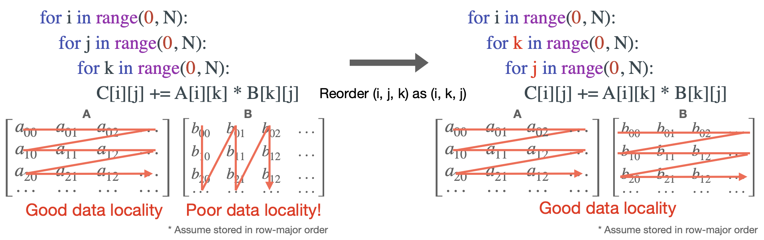
7. Mapping & Dataflow
Dataflow Choice (Loop reordering)
Example: 2D Convolution
MCUNet: Tiny Deep Learning on IoT Devices [Lin et al., NeurIPS 2020]
On-Device Training Under 256KB Memory [Lin et al., NeurIPS 2022]
Notes:
C00 = a00*b00 + a01*b10 + a02*b20
C01 = a00*b01 + a01*b11 + a02*b21
…
C00 += a00*b00, C01 += a00*b01, C02 += a00*b02
C00 += a01*b10, C01 += a01*b11, C02 += a01*b12

Slide 16
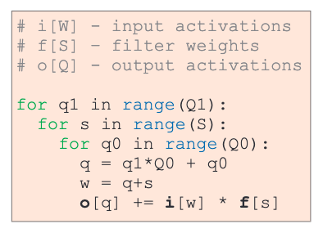
7. Mapping & Dataflow
Example: hierarchical tiling
Loop Tiling
registers
Choose a tile size on which to operate
Practically: Break a loop into 2 loop
Can break into multiple loops, each can be mapped hierarchically onto a memory system
SRAM
DRAM
Tiling
Number of tiles
Size of a tile
q1 | 0 | 0 | 0 | 0 | 0 | 0 | 0 | 0 | 0 | 0 | 0 | ..
q0 | 0 | 1 | 2 | 3 | 0 | 1 | 2 | 3 | 0 | 1 | 2 | ..
Output (q) | 0 | 1 | 2 | 3 | 0 | 1 | 2 | 3 | 0 | 1 | 2 | ..
Input (w) | 0 | 1 | 2 | 3 | 1 | 2 | 3 | 4 | 2 | 3 | 4 | ..
Weight (s) | 0 | 0 | 0 | 0 | 1 | 1 | 1 | 1 | 2 | 2 | 2 | ..
Output (q) | 0 | 1 | 2 | 3 | 4 | 5 | 6 | 7 | 8 | 0 | 1 | ..
Input (w) | 0 | 1 | 2 | 3 | 4 | 5 | 6 | 7 | 8 | 1 | 2 | ..
Weight (s) | 0 | 0 | 0 | 0 | 0 | 0 | 0 | 0 | 0 | 1 | 1 | ..
Adapted from “Machine Learning Hardware and Systems” Lecture (Fall 2024) by Prof. M. Abdelfattah (Cornell Tech)
Notes:
Q: output 8개
Q1: 2개 tile
Q0: 4개/tile

Slide 17
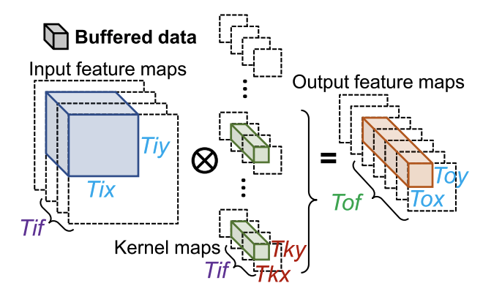
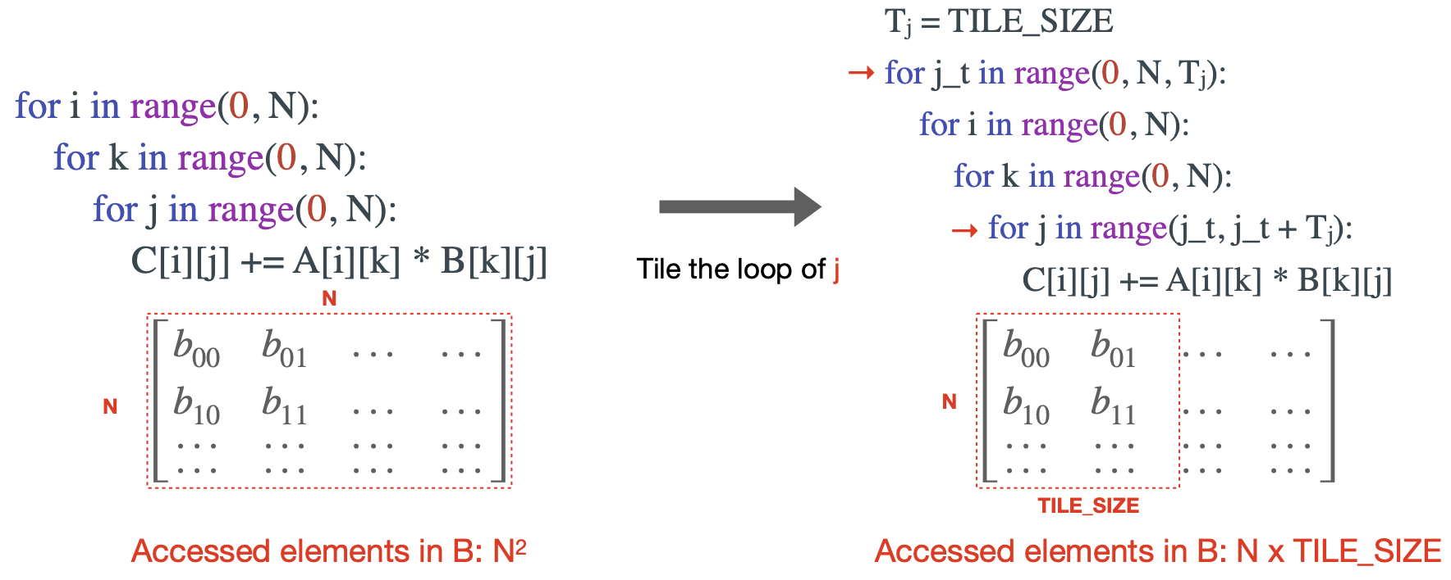
7. Mapping & Dataflow
Loop Tiling
Example: 2D Convolution
Adapted from “TinyML and Efficient Deep Learning Computing” Lecture (Fall 2024) by Prof. Song Han (MIT)

Slide 18
7. Mapping & Dataflow
Loop Unrolling
Overheads of loop control
Arithmetic operations for pointers (e.g., i, j, k)
End of loop test (e.g., k < N)
Branch prediction
Reducing the overheads by loop unrolling
Replicate the loop body a number of times
Tradeoﬀ between binary size and reduced overheads
Adapted from “TinyML and Efficient Deep Learning Computing” Lecture (Fall 2024) by Prof. Song Han (MIT)

Slide 19
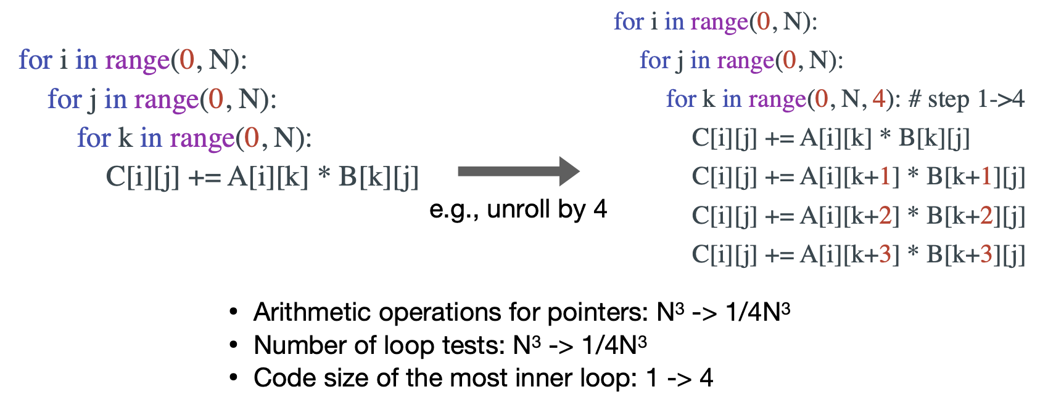
7. Mapping & Dataflow
Loop Unrolling
Adapted from “TinyML and Efficient Deep Learning Computing” Lecture (Fall 2024) by Prof. Song Han (MIT)

Slide 20
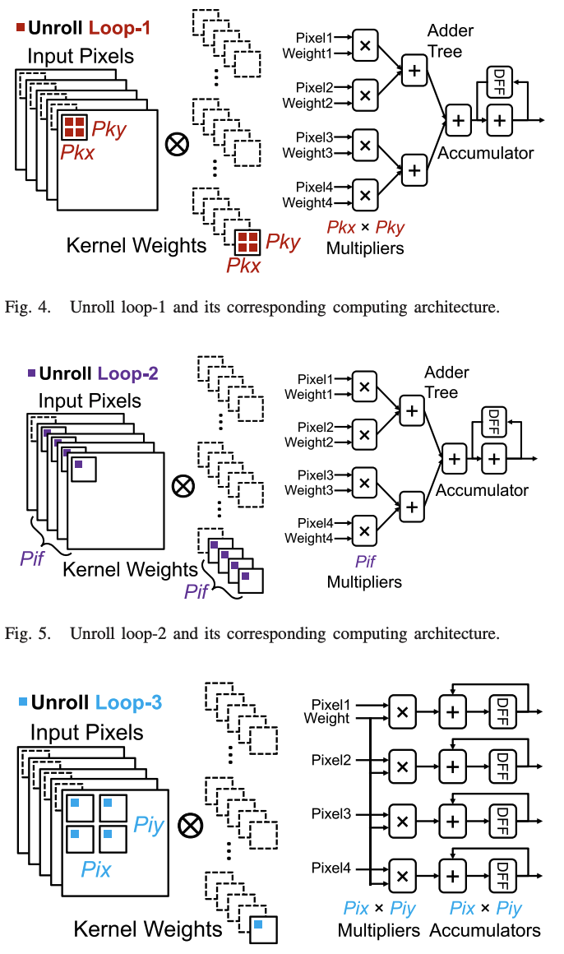
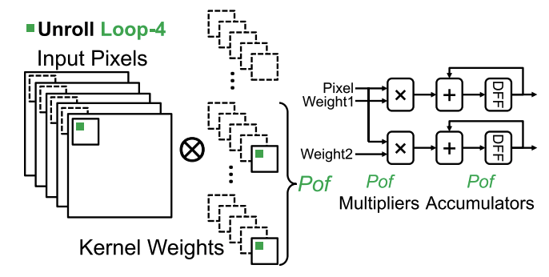
7. Mapping & Dataflow
Loop Unrolling
Y. Ma et al., Optimizing the Convolution Operation to Accelerate Deep Neural Networks on FPGA

Slide 21
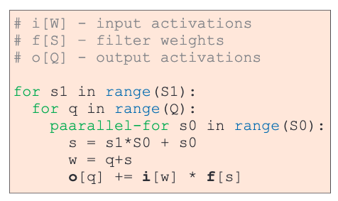
7. Mapping & Dataflow
Vectorization
Parallelize operations within your smallest tile
Not possible without tiling!
Tiling mainly done to fit the data in various parts of the memory hierarchy
Vectorizing the smallest tile is done to leverage hardware parallelism
Number of tiles
Vectorization
Size of a tile
Tiled
Tiled + Vectorized
Adapted from “Machine Learning Hardware and Systems” Lecture (Fall 2024) by Prof. M. Abdelfattah (Cornell Tech)
Notes:
• 원래 구조: innermost loop가 q0에 대해 돌면서 s는 고정. 이 경우, i[w]는 q0에 따라 연속적일 수 있지만, f[s]는 스칼라값으로 남아있어 벡터화에서 모든 루프 변수가 연속적으로 변하는 장점을 충분히 활용하지 못할 수 있습니다.
• 변경된 구조: innermost loop가 s0에 대해 돌면서, s가 s1와 s0에 의해 연속적으로 증가합니다. 이로 인해 f[s]와 i[q+s]의 메모리 접근이 연속적이 되어, SIMD 벡터화의 이점을 극대화할 수 있습니다.

Slide 22
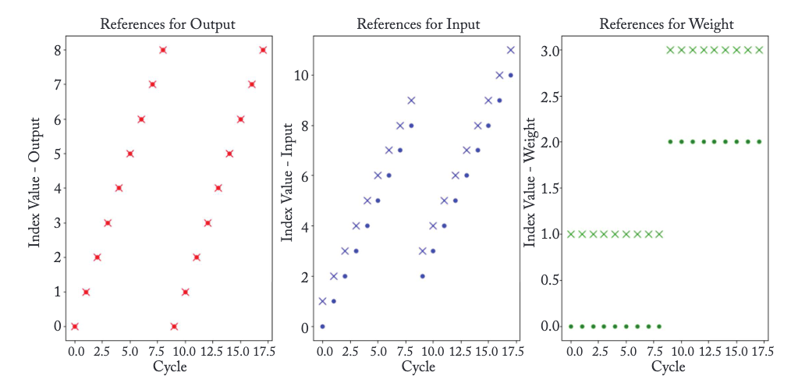
7. Mapping & Dataflow
Tiled + Vectorized
Tile size?
# PEs/Cores ?
2
Adapted from “Machine Learning Hardware and Systems” Lecture (Fall 2024) by Prof. M. Abdelfattah (Cornell Tech)

Slide 23

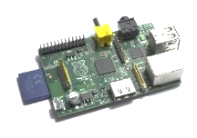
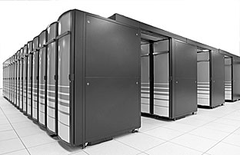

7. Mapping & Dataflow
Edge-Cloud Collaborative Inference
Edge platform
Cloud platform
Wireless
TX
‘car’
Goal:
Partition DNN inference for
minimum energy and maximum throughput at the edge platform
Limited resources
Energy
TX bandwidth
[1] J. H. Ko et al., Edge-Host Partitioning of Deep Neural Networks with Feature Space Encoding for Resource-Constrained Internet-of-Things Platforms, AVSS 2018
[2] M. F. Amir, J. H. Ko et al., 3-D Stacked Image Sensor With Deep Neural Network Computation, IEEE Sensors Journal, 2018
[3] B. A. Mudassar, J. H. Ko et al., Edge-cloud collaborative processing for intelligent internet of things: a case study on smart surveillance, DAC 2018

Slide 24
7. Mapping & Dataflow – Collaborative Inference
Three Inference Approaches to Edge-Cloud Collaboration
Edge platform
Cloud platform
Entire inference at the cloud
‘car’
Wireless TX
Entire inference at the edge
‘car’
‘car’
Intermediate
feature
Edge-cloud partitioned inference
‘car’
Encoding
Decoding

Slide 25
7. Mapping & Dataflow – Collaborative Inference
Tradeoff between Computation/Memory & Transmission
More layers at edge
-> Computation/
memory demand ↑
-> Transmission demand ↓
Input
conv1
conv2
conv3
conv4
conv5
fc6
fc7
fc8
(Analysis with AlexNet)
Edge inference
Host inference
Layer to partition

Slide 26

7. Mapping & Dataflow – Collaborative Inference
Fine Tuning of Partitioned Network
conv1
conv5
Partitioned network at the host platform
output feature
Original
output feature
Encoded
output feature
fc6
fc7
…
fc8
Encoding with range of QF for target accuracy
Fine tuning
QF=30
11% increase
Fine tuning of a partitioned network with encoded intermediated features
→ enhance compression performance
QF=35
Target accuracy
QF=40

Slide 27
7. Mapping & Dataflow – Collaborative Inference
Throughput/Energy Analysis
Throughput
Min. system energy & Max. system throughput @ end of conv layers
Energy
Input
conv1
conv2
conv3
conv4
conv5
fc6
fc7
fc8

Slide 28
7. Mapping & Dataflow – Collaborative Inference
Throughput/Energy Advantages
Partitioned
inference
2.3x throughput ↑
2.5x E efficiency ↑
Inference
at edge
15.3x throughput ↑
16.5x E efficiency ↑
Inference
at cloud

Slide 29
7. Mapping & Dataflow – Collaborative Inference
Analysis on Network type
VGG-16
ResNet-50
Partitioned
Partitioned
Edge
Cloud
Edge
Cloud
Large FC layers → entire at cloud than edge
Deep conv layers + one FC layer → entire at edge than host
Partitioned inference is better than entire cloud or edge inference

Slide 30
7. Mapping & Dataflow – Collaborative Inference
Analysis on Transmission Channel
Low BW (1 Mbps)
High BW (22 Mbps)
Partitioned
Partitioned
Cloud
Edge
Edge
Cloud
BW ↑ → cloud inference performance ↑
Partitioned inference outperforms for both BW

Slide 31
7. Mapping & Dataflow – Collaborative Inference
Analysis on Transmission Channel
Partitioning layer for min energy
conv2
host
conv1
conv5
fc6
edge
conv1
Wifi (@22Mbps)
conv2
Partitioning at
last conv layer (conv5)
covers wide range of TX models
Bluetooth (@2Mbps)
Partitioning layer for max throughput
Bluetoogh low-energy (@ 1Mbps)
Wifi (@1Mbps)
conv5
fc6
edge

Slide 32
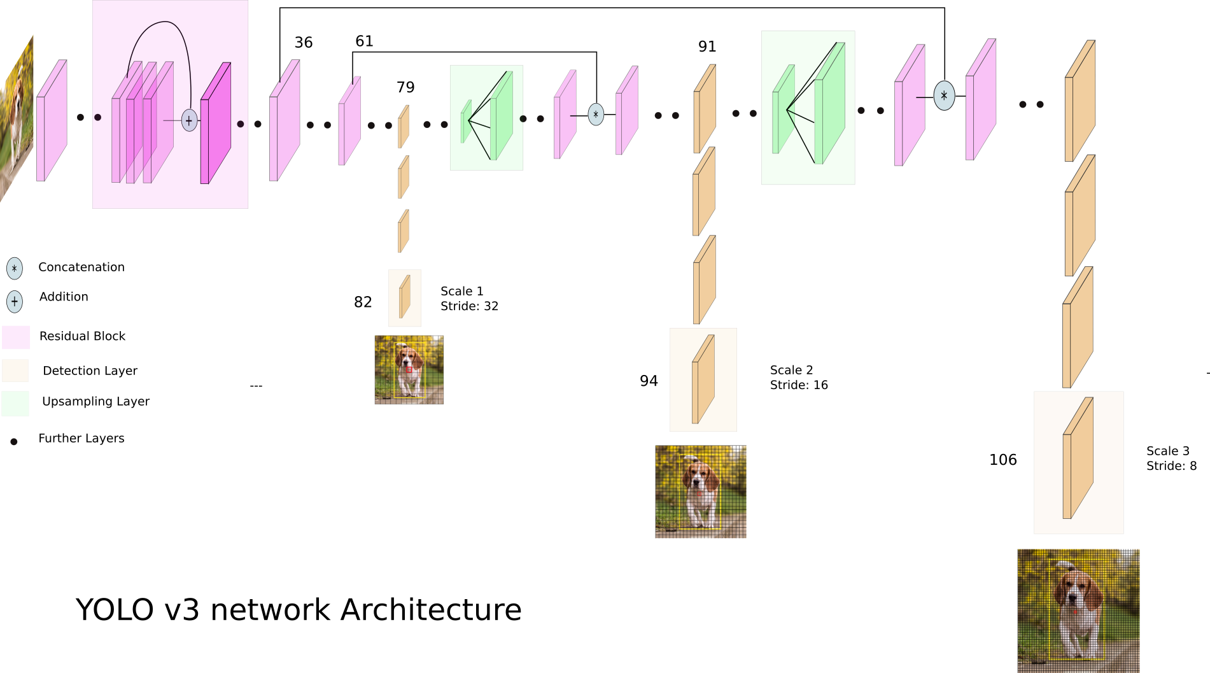
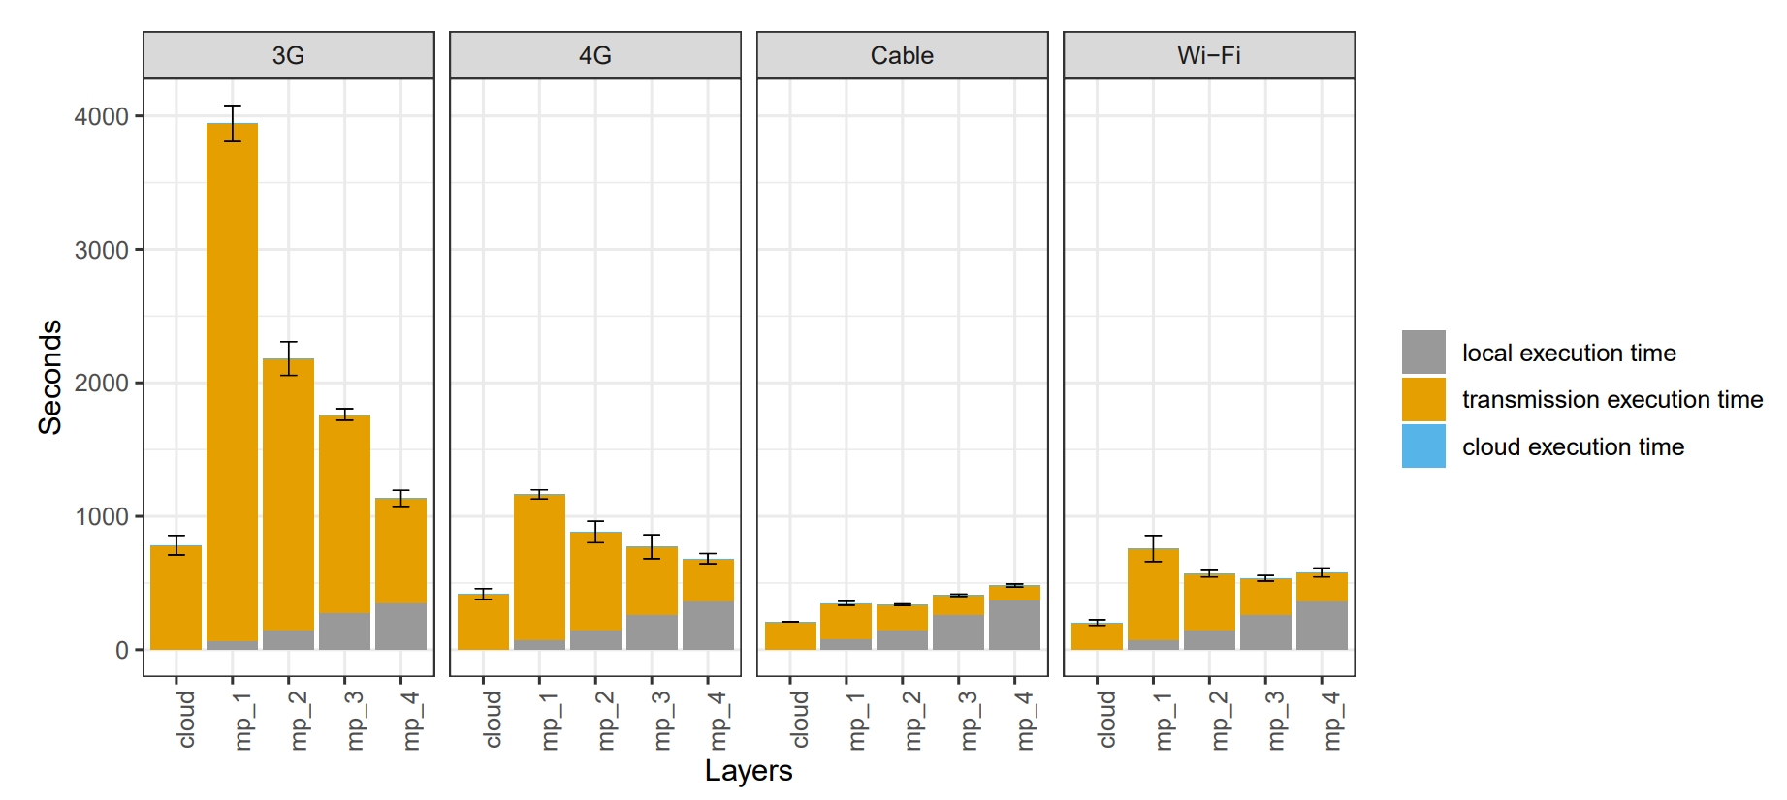
7. Mapping & Dataflow – Collaborative Inference
Partitioning of OD (YOLO) Models
YOLO v2 architecture imposes difficulties for partitioning
Input of a layer after the split point may depend on the multiple previous layers
Entire edge or cloud inference is still better
W. Magalhães et al., Evaluating Edge-Cloud Computing Trade-Offs for Mobile Object Detection and Classification with Deep Learning, Journal of Information and Data Management, 2020

Slide 33
7. Mapping & Dataflow – Collaborative Inference
Feature Reconstruction with Asymmetric Scaling
<Baseline structure>
<Proposed structure>
Edge
Cloud
Edge
Cloud
Neck
Neck
BBOXs / Labels
BBOXs / Labels
Image
Image
Backbone
Backbone
Feature
reconstruction
network
Asymmetric scaling

Slide 34
7. Mapping & Dataflow – Collaborative Inference
Feature Reconstruction with Asymmetric Scaling
Latency (ms)
Partitioned (baseline)
Partitioned (baseline)
Partitioned (baseline)
Partitioned (proposed)
Partitioned (proposed)
Partitioned (proposed)
5Mbps
10Mbps
20Mbps
J. C. Lee, Y. Kim, S. Moon and J. H. Ko, "A Reconfigurable Neural Architecture for Edge–Cloud Collaborative Real-Time Object Detection," in IEEE Internet of Things Journal, 2022, doi: 10.1109/JIOT.2022.3205682.
34

Slide 35
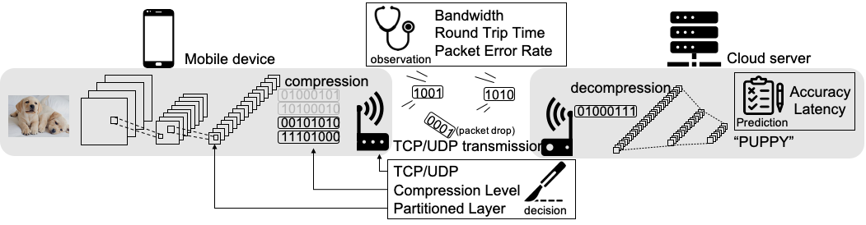
7. Mapping & Dataflow – Collaborative Inference
Intermediate Feature Transmission
Feature transmission is lossy
Due to bit error, packet loss, …
Solutions
Optimal partition point search under lossy environment
Feature loss recovery
Loss-augmented training
Kim H, Choi JS, Kim J, Ko JH. A DNN partitioning framework with controlled lossy mechanisms for edge-cloud collaborative intelligence. Future Generation Computer Systems. 2024 May 1;154:426-39.

Slide 36
Thank you!
Lecture 6: Polling and Interrupt
Questions or comments?
Jong Hwan Ko
SungKyunKwan University, Korea
Department of Information and Communication Engineering
jhko@skku.edu

